Slide 1
Data Utility Tool for Auto Join Discovery
Campus Innovation Case Study
Name: SHIBIKASRI G
Role: Software Developer / CSE
Date: 9th February

Slide 2
Introduction
Databases usually store data in multiple tables to keep information organized. To get meaningful results, developers need to join these tables together using SQL joins. But in real-world projects, identifying correct joins and understanding relationships between tables can take a lot of time and effort. This project focuses on creating a simple data utility tool that automatically finds possible joins between tables and helps developers write better and faster queries.

Slide 3
Problem Statement
In many databases, developers have to manually analyze tables and columns to identify how they are related. This process becomes difficult when the database grows larger. Wrong joins can slow down queries and affect application performance. Many beginners and even experienced developers spend extra time figuring out relationships. So there is a need for a smart tool that can automatically detect joins and give performance improvement suggestions.

Slide 4
Objectives
Automatically detect join relationships
Reduce manual effort in database analysis
Improve SQL query performance
Suggest optimized joins
Provide indexing recommendations
Help developers understand database structure faster

Slide 5
Technologies Used
Python
SQLite Database
SQL Concepts
Automation Script
Basic Database Optimization Techniques

Slide 6
System Workflow
Connect to database
Read table names
Extract columns from each table
Identify common ID columns
Generate optimized join suggestions
Provide performance recommendations

Slide 7
Methodology
The system connects to the database and reads the schema information of all tables. It then compares column names across tables and identifies matching ID fields that can be used for joins. After detecting relationships, the tool generates optimized join suggestions and also recommends performance improvements like indexing and proper join types. The goal is to make database analysis faster and more efficient.

Slide 8
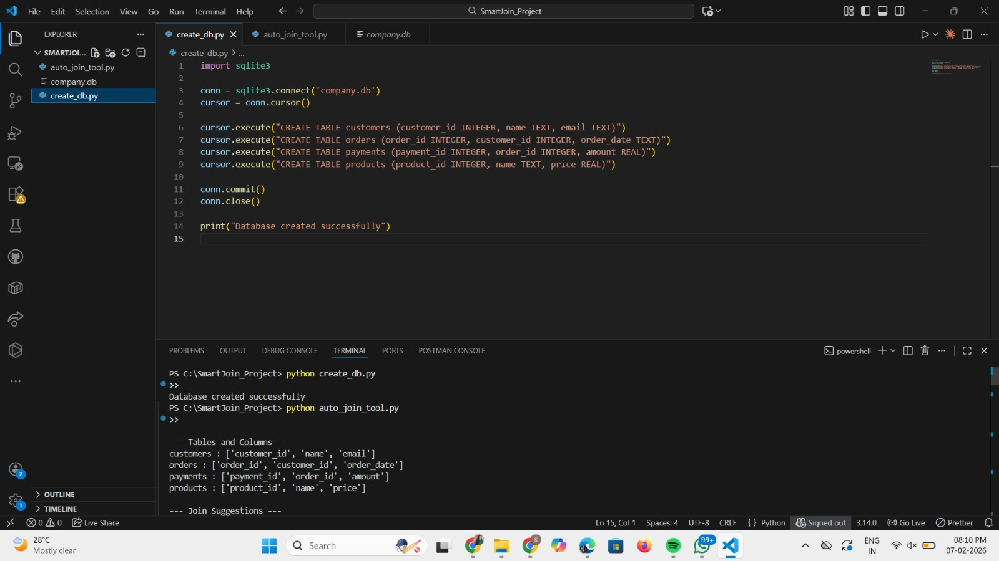

Slide 9
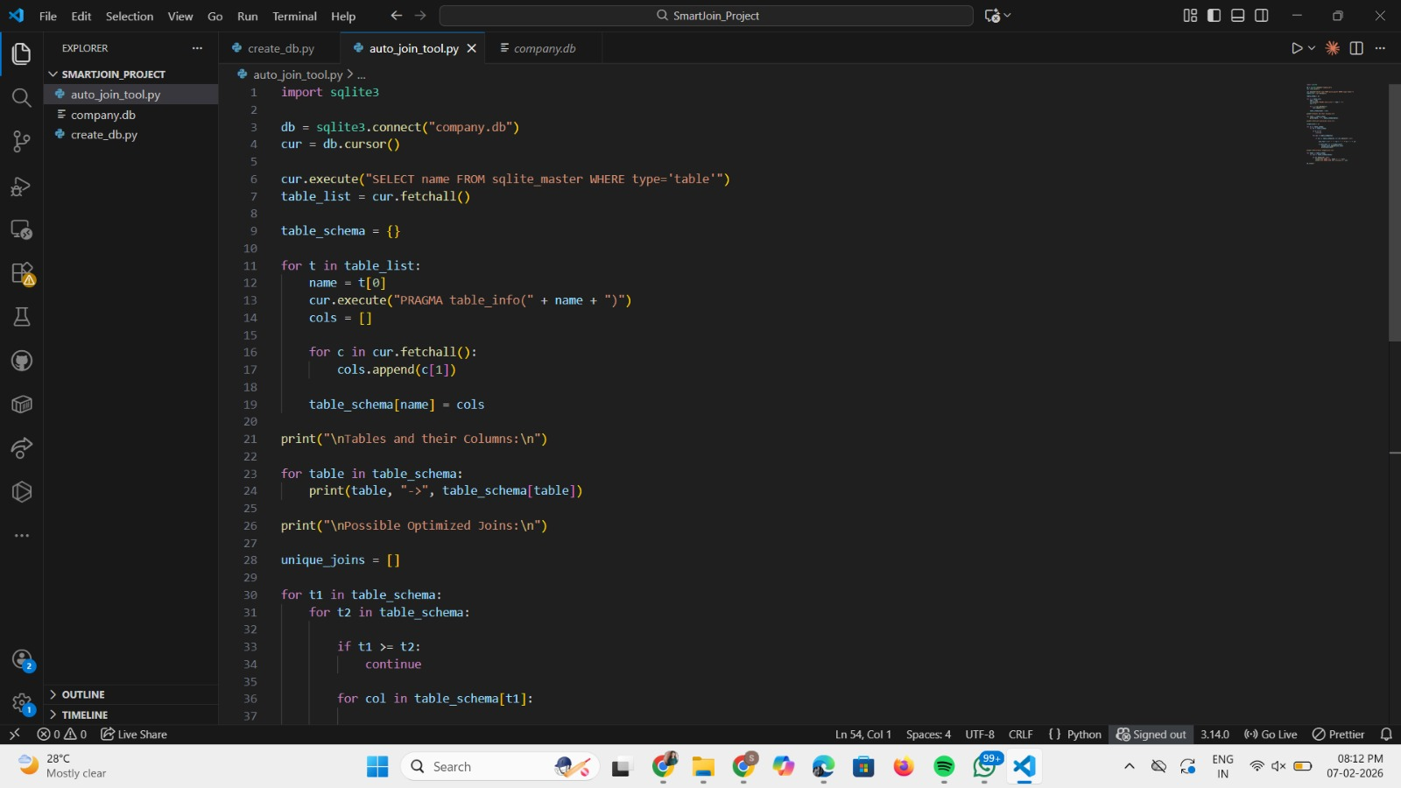

Slide 10
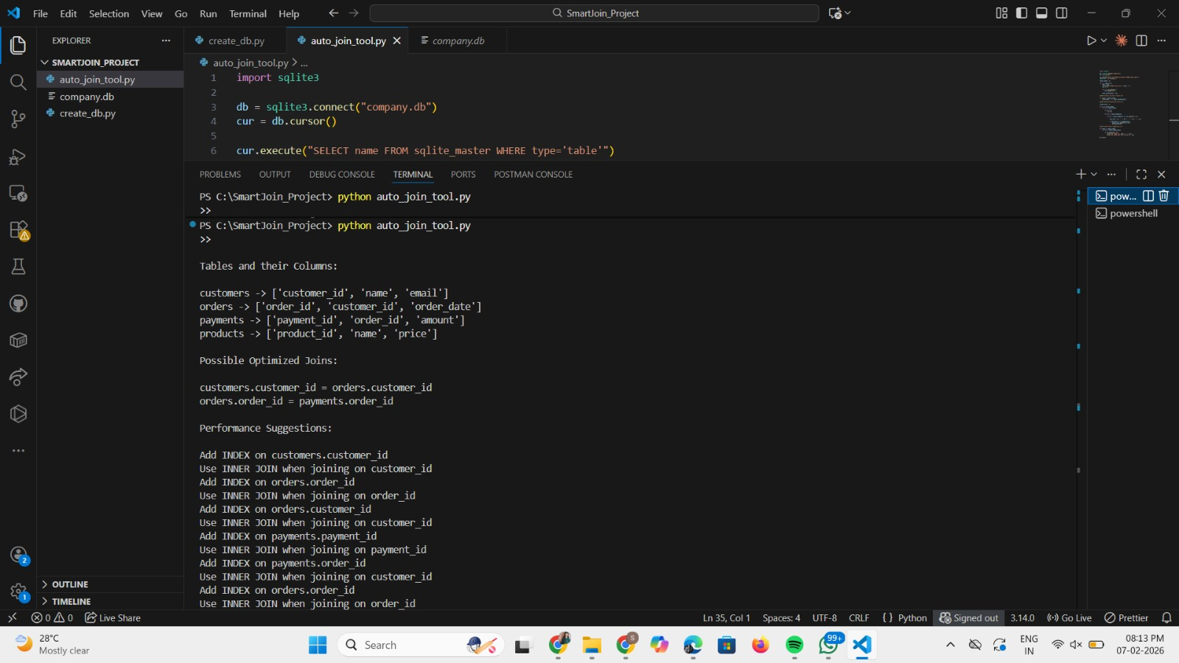

Slide 11
Performance Optimization Suggestions
Suggest INDEX on ID columns
Recommend INNER JOIN usage
Improve query execution speed
Reduce database scanning
Enhance data retrieval performance

Slide 12
Advantages
Beginner-friendly tool
Saves development time
Improves database performance
Easy automation using Python
Helps in large database analysis

Slide 13
Future Enhancements
Support MySQL & SQL Server
GUI-based interface
AI-based join prediction
Query optimization engine
Cloud database integration

Slide 14
Conclusion
This project demonstrates how automation can simplify database analysis and improve performance. By automatically detecting joins and suggesting optimizations, the tool helps developers save time and reduce errors. It is a practical solution that can be extended further to support more complex databases and intelligent optimization techniques in the future.

